Slide 1
Small Size League Challenge
Introduction
2017.09.20

Slide 2
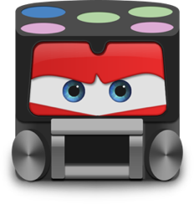
Introduction
The RoboCup SSL Chanllenge (Small Size League Chanllenge) is a soccer technical chanllenge league based on RoboCup Soccer Small Size League where all teams participate using the same standard robot,Vision system, Referee system. The teams play on a green field with white lines, with no other landmarks and the ball is a standard orange golf ball. All teams should write robot movement procedures(by c++ language) and strategy scripts(by Lua script language) for competitions.
C++
Lua

Slide 3
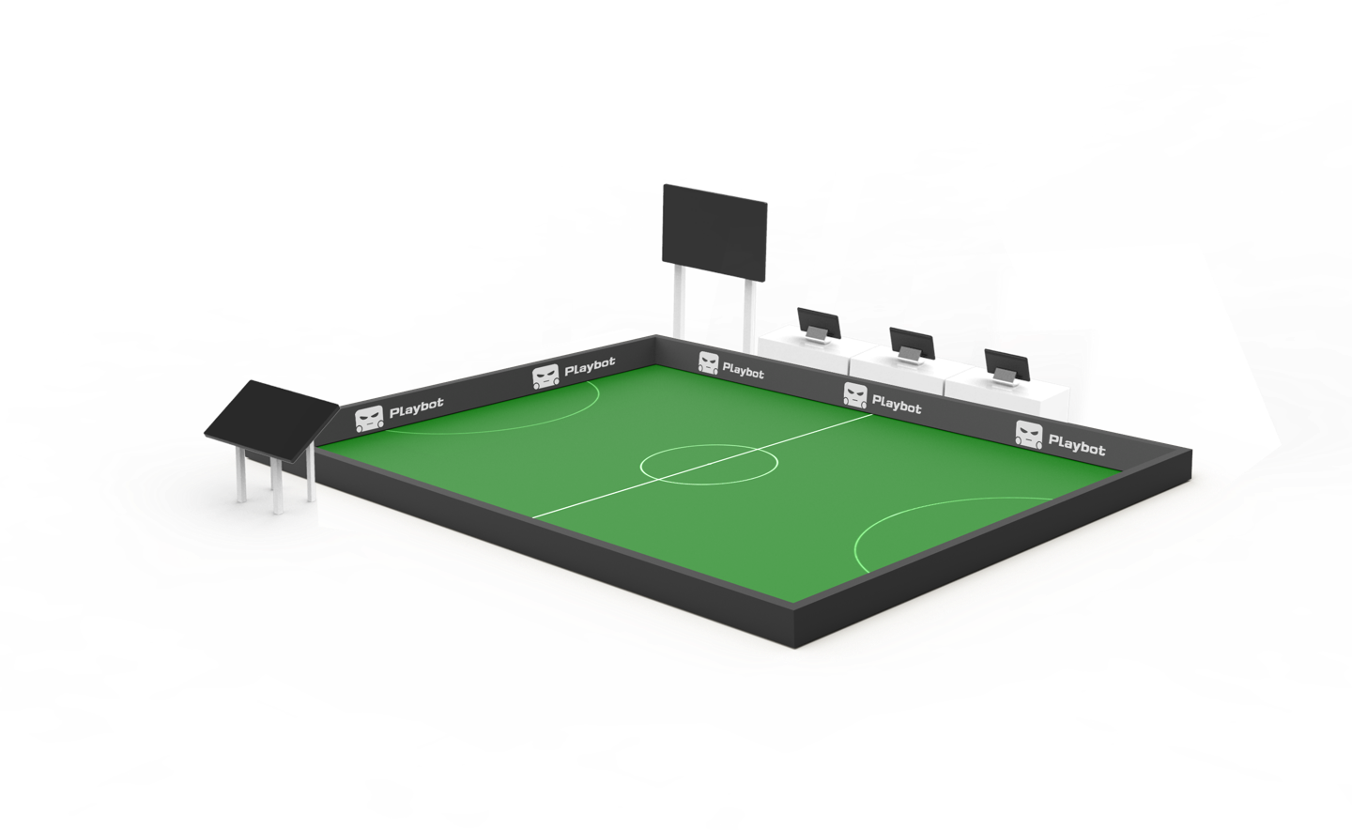
5 System
Vision system：as Robot’s eyes
＞＞＞＞＞＞＞＞＞＞＞＞＞＞＞＞＞＞＞＞＞＞＞
＞＞＞＞＞＞
＞＞＞＞＞＞＞＞＞＞＞
Decision Making System：
as Robot’s brain
Robot：as Robot’s body
Communication system：as Robot’s Neural Network
Run-time system：provides the necessary environment for robot operation

Slide 4
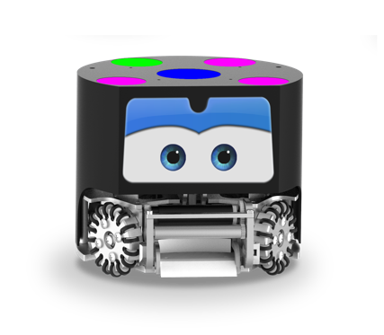
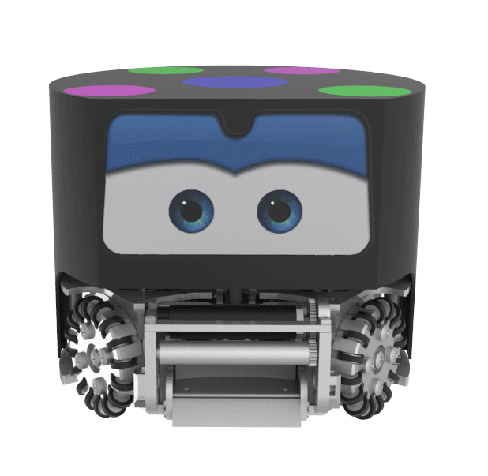
Small and powerful ball control mechanism
Excellent wear and strength properties
Equipped with a motor,can move a short distance with controlling the ball.
Use high strength metal body and frosted PC shield to maximize the protection of the internal structure.Keep balance and not easy to damage.
Ingenious shoot mechanism
Omnidirectional wheel capable of moving in all direction.
Using electromagnetic drive to achieve shooting.So the robots can shoot and pass the ball acc urately and rapidly.
Each robot is equipped with four brushless motors and wheels,can move in all directions.

Slide 5
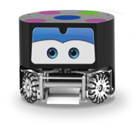
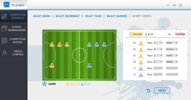
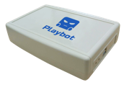
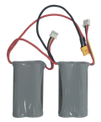
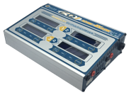
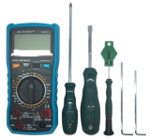
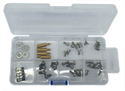
software
platform
ES Robot
USBKey
transmitter
Dedicated lithium battery
Battery charger
The ball
Color paper
Stickers
Tool kit
Robot parts
User's manual

Slide 6
1-Vision System
1. Direction
Camera ×2
wide
front
Vision server
narrow
back
2. Different Team
3. Different Member
Field of vision
Yellow Team
ID = 0
NUM=1
hat
Blue Team
ID = 9
NUM=10

Slide 7
2-Decision Making System
The Decision Making System establishes a multi-robot collaborative hierarchical decision-making framework based on limited state machine，PAS
P A S
01
Decision Design
02
Task assign
Play layer
03
Action exectue
Agent layer
Skill layer

Slide 8
3-Communication system
Move
Control ball
Shoot
……
Movement command
State information
Identity
Battery
……

Slide 9
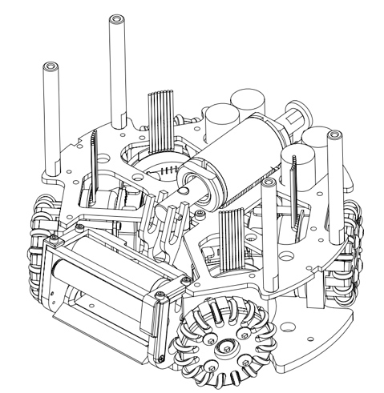
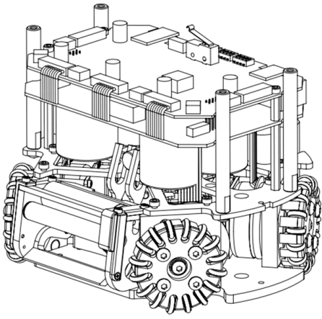
4-Robot
Contral
board
Electrical structure
Boost
board
Control the mechanical structure to move,control ball, shoot ……
Mechanical structure
Include move model,control ball model,shoot ball model……

Slide 10
4-Robot
Chip shoot model
Chip shoot
Control ball model
Roller rotate to control ball
Flat shoot model
Flat shoot

Slide 11
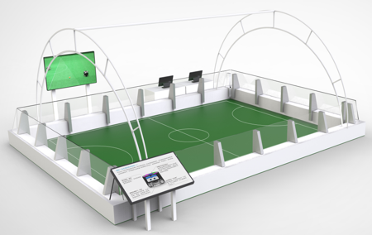
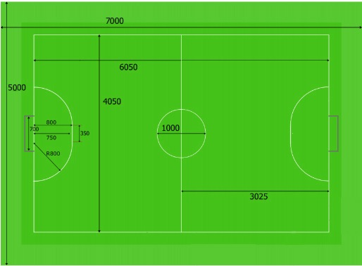
5-Run-time system
Set up vision system
Set upLocal area network
Reduce the effects of natural light
Ensure the lighting conditions are consistent
Keep the field clean

Slide 12
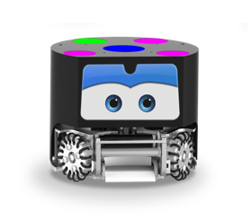
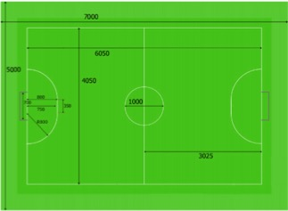
SSL Challenge Rule
The Match
Grouping
The Robot
All teams are required to use the same standard robot, and program robot movement procedures and strategy scripts for the competition. The specification of the robot is required as same as international standards (F180 standard). It has the functions of omnidirectional movement, dribbling , kick and chip.
The match lasts two equal periods of 10 minutes.Teams are entitled to an interval at halftime. The half-‐time interval must not exceed 5 minutes.
Each team is allocated four timeouts at the beginning of the match. A total of 5 minutes is allowed for all timeouts.
Undergraduate group: 4 VS 4
Secondary group: 3 VS 3
The Field
The Ball
The field of play must be rectangular, of nominal size 4050mm×6050mm and lay a green carpetas as shown in the fig.1. Goal height is 155mm, depth is 180mm, width 700mm and painted with white.
For each field half the penalty mark is 750mm from the midpoint between the goalposts and equidistant to them. The mark is a 10mm diameter circle of white paint.
Use standard orange golf ball.

